Slide 1
ENHANCED IDEABOT AI–POWERED PROJECT IDEATION ASSISTANT
Innovation & Design Thinking
GUIDED BY :
DR. SURESH KUMAR S
Project members:
Prasanna S (221801038)
Rohith RA (221801041)
Sivabalamurugan (221801050)

Slide 2
Problem Statement
Students and early developers often struggle to come up with innovative and feasible project ideas aligned with their interests, skills, and time constraints. Traditional brainstorming methods are time-consuming, non-personalized, and heavily reliant on peer or mentor input.
Moreover, generic project suggestion websites lack interactive, adaptive intelligence and fail to guide users step-by-step. There is a clear need for an intelligent assistant that can actively converse with the user, collect their preferences, and dynamically generate personalized, high-quality project ideas.

Slide 3
Abstract
This project proposes IdeaBot – an AI-powered chatbot that interacts with users, understands their interests and constraints, and recommends personalized project ideas in real-time.
It uses Natural Language Processing (NLP) to converse with the user, gather input such as domain preferences, technologies known, time availability, and collaboration style, and then forwards the structured prompt to a local LLM (like LLaMA or Mistral) for idea generation.
The backend uses Python Flask to manage chat history and responses, while the frontend provides an interactive UI built with HTML, CSS, and JavaScript. The system aims to reduce ideation time, promote innovation, and assist students in selecting relevant and achievable project goals.

Slide 4
Existing System
Static Web Lists: Users browse through predefined project idea lists, which lack personalization or adaptation to user needs.
YouTube and Blogs: Often present either too generic or overly complex ideas with no real guidance.
Peer Brainstorming: Time-consuming and limited by the knowledge and creativity of the group.
AI Tools (e.g., ChatGPT) without structured prompting: These provide random results unless expertly queried.

Slide 5
Limitations
No Structured Question Flow: Traditional tools don't guide users step-by-step, often resulting in vague or incomplete input.
Lack of Personalization: Suggested ideas are generic and not tailored to the user’s skills, interests, or constraints.
No Relevance Justification: Existing systems don’t explain why a particular idea suits the user's background or goals.
No Conversational Memory: Each user message is treated independently, leading to disconnected or inconsistent suggestions.
No Iterative Feedback Support: Users can’t refine or adjust suggestions through follow-up conversation.

Slide 6
Proposed System
Structured Question Flow: Asks predefined questions (e.g., domain, tech stack, time, difficulty) to gather complete and relevant user input.
Session Memory: Stores all answers during the session to maintain context and coherence in idea generation.
Prompt Generation: Combines user responses into a natural-language prompt tailored for the LLM to produce relevant ideas.
LLM-Powered Output: Uses a local LLM (like LLaMA via Ollama) to generate structured, personalized project suggestions.
Real-Time Response Formatting: Cleans and displays results in a readable, point-wise format via the chat interface.

Slide 7
System Architecture
Data Collection Layer: Collects student interaction logs, test results, learning resource engagement, and contribution metrics.
Preprocessing Layer: Cleans and formats time-series data, structures interaction timelines, and extracts behavioral features.
AI Processing Layer:
TCN: Predicts user engagement drop-offs and content mastery.
DRL: Determines rank promotion readiness, resource unlocking.
Fuzzy Logic: Manages user queries and chatbot tone adaptively.
Integration Layer: Manages communication between AI modules and frontend/backend using message queues or brokers.
Frontend Application: Provides chatbot UI, rank dashboard, test modules, and peer Q&A panels.
Output: Improved student learning outcomes, retention, engagement, and satisfaction.

Slide 8
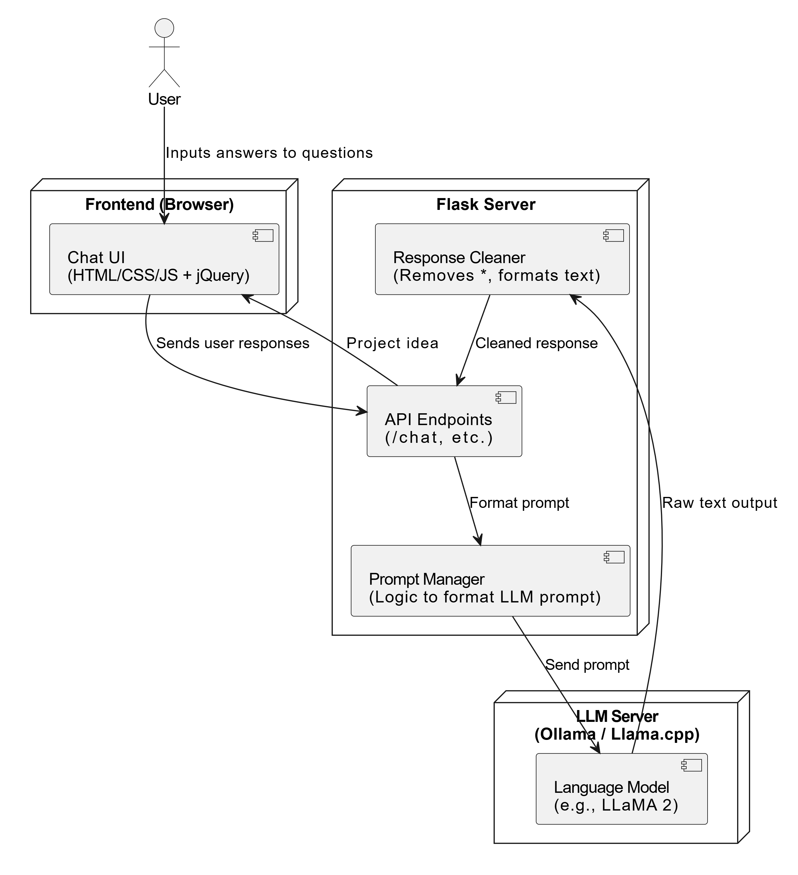

Slide 9
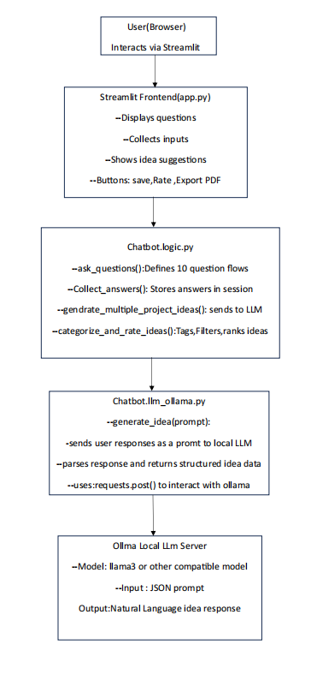
Outputs:

Slide 10
Modules
1. User Interaction Module: Handles chat input, displays conversation flow dynamically
2. Question Management Module: Delivers sequential questions and tracks answers
3. Prompt Generator: Builds context-rich prompts for the LLM based on user preferences
4. LLM Response Processor: Communicates with local Ollama server, receives ideas
5. Response Formatter: Cleans and formats responses (removes asterisks, markdown symbols, etc.)
6. Admin Dashboard (Future Enhancement): Logs responses, feedback, and export session data

Slide 11
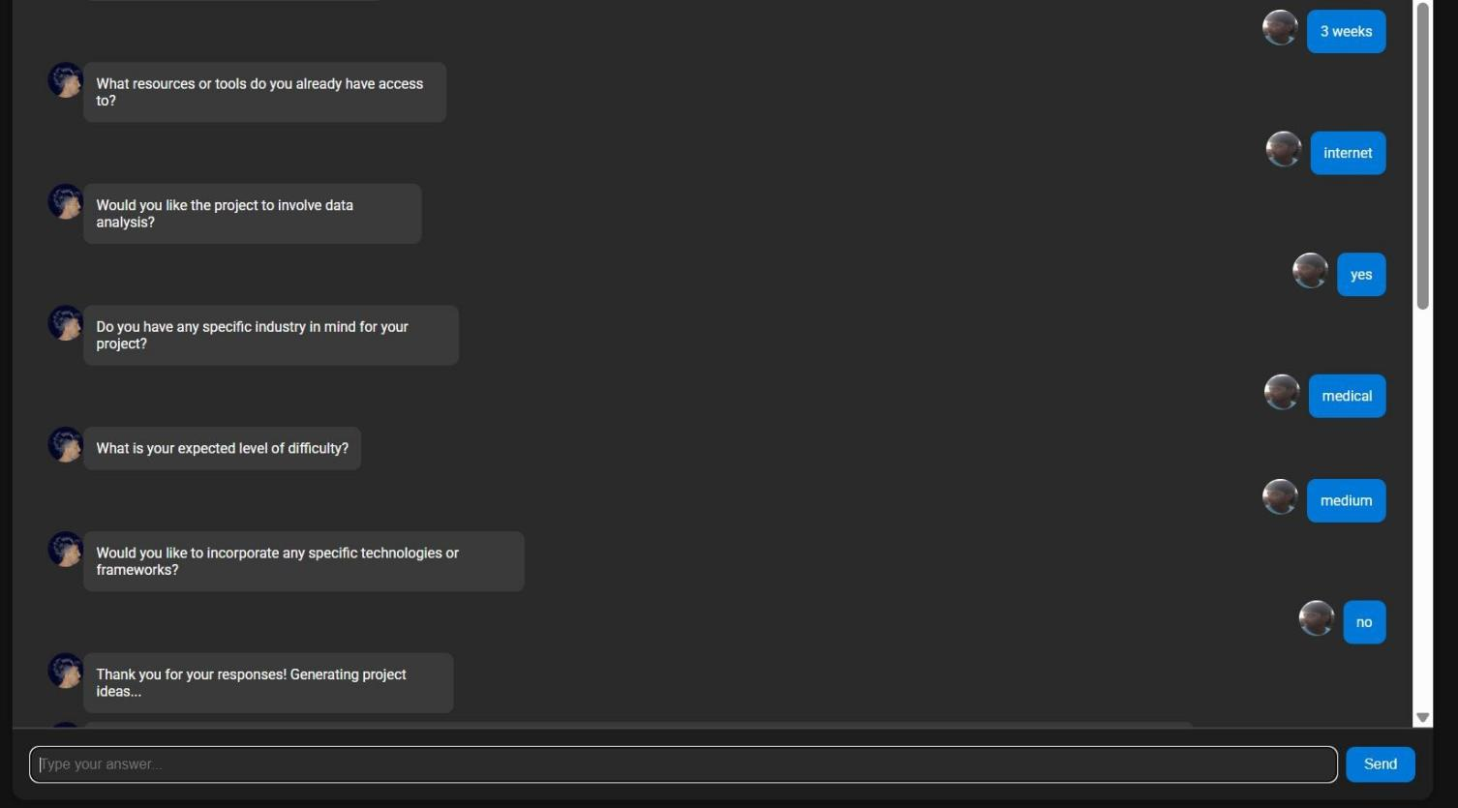
Outputs

Slide 12
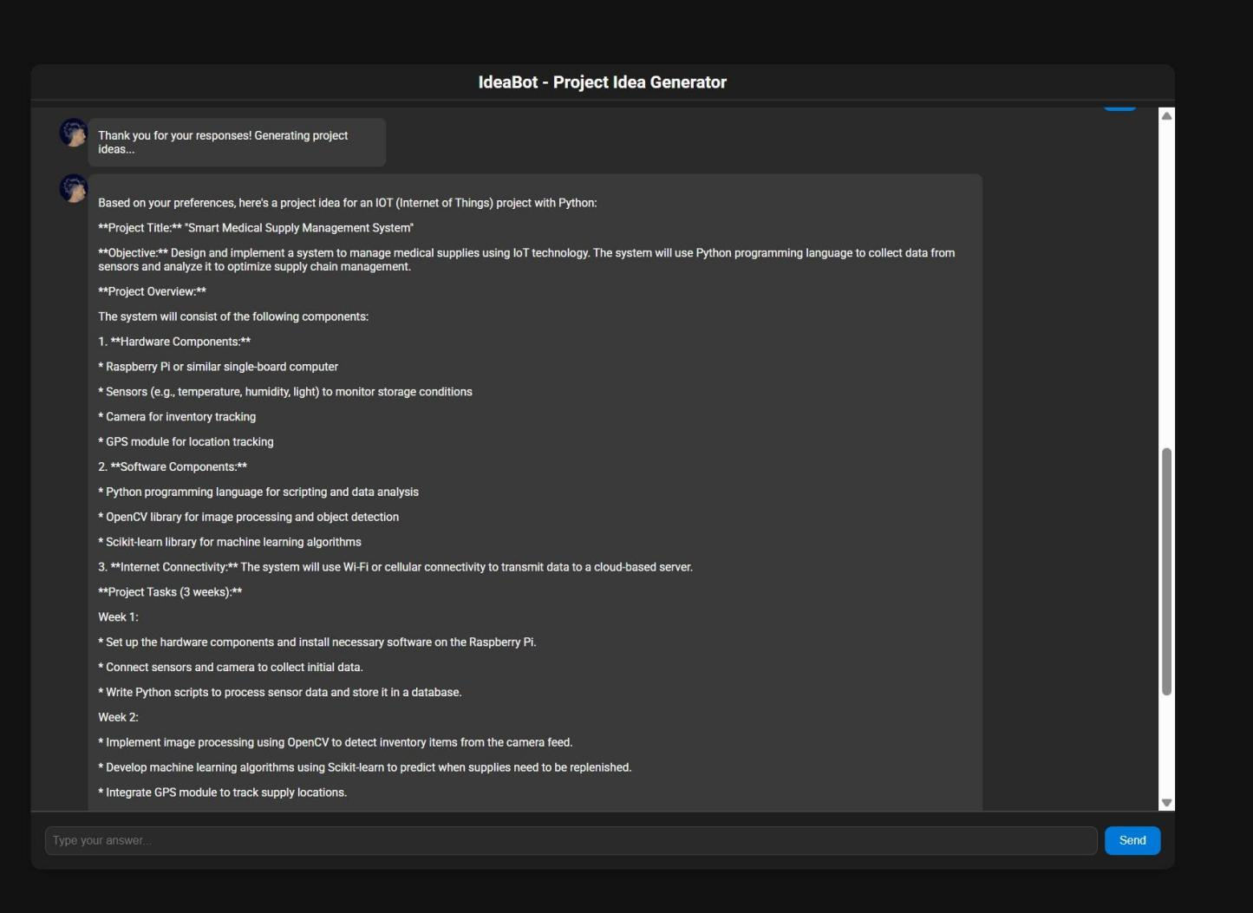

Slide 13
Future Enchancements
Add support for exporting generated ideas to PDF
Enable user login to save sessions
Add domain-specific filters (e.g., hardware, AI, web dev)
Add rank-based suggestions (for beginner/intermediate/advanced)
Mobile-friendly UI with chatbot integration
Integrate public project repositories for inspiration

Slide 14
Conclusion
IdeaBot offers an intelligent and dynamic approach to project ideation. Unlike static or generic platforms, it provides a guided, personalized experience that results in relevant and actionable project ideas. By combining the power of conversational AI, structured prompting, and LLM integration, the tool simplifies the brainstorming process for students and developers alike. With future enhancements, IdeaBot can evolve into a comprehensive project planning assistant across domains.

Slide 15
Thank you!

